Slide 1





RuxaiLab
Sentiment Analysis for
Usability Tests
GSoC 2024
Meet #6: Finalizing Integration to RuxaiLab <3
Presented By: Olivia Wilson
19-08-2024 22:00 (UTC+3)

Slide 2


Agenda
New Features
Demo
Pull Request
API Repo ReadME
API Documentation
Coding & Wikki Docs
Timeline & Tasks
Final Submission
Contribution After GSoC
Questions To Mentors
Feedback

Slide 3


New Features Added
Documentation to the code [Model/controllers]
Coordinators Section
Transcription Section
Play Segment
Delete Segment
Volume Controller
Speed Controller

Slide 4
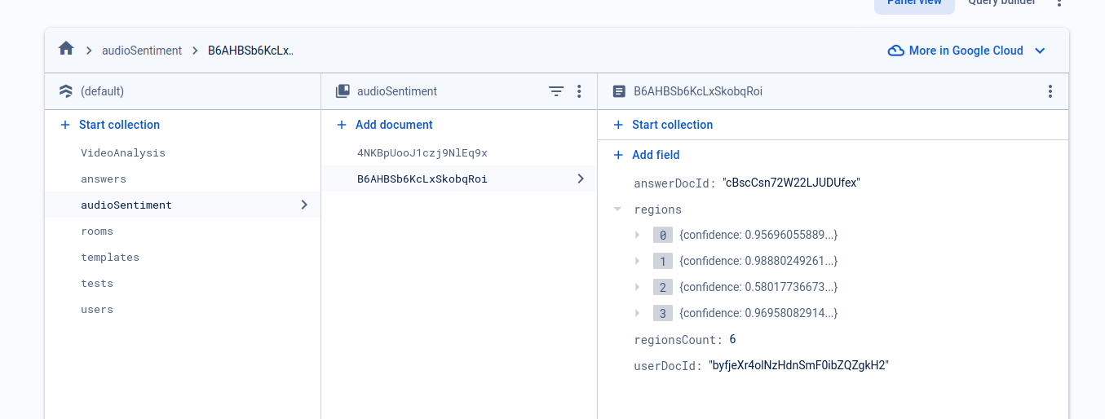
Fixed Model

Slide 5
Demo
Let’s try the new Features added to RuxAiLab

Slide 6


Pull Request
Merged Develop Branch to the audio sentiment branch
Fixed Merge Conflicts
Opened the PR to this integrated Feature [link]
Notes:
We use localhost:8000 to call the api ⇒ where to put the .env file
Will I need to modify the PR

Slide 7

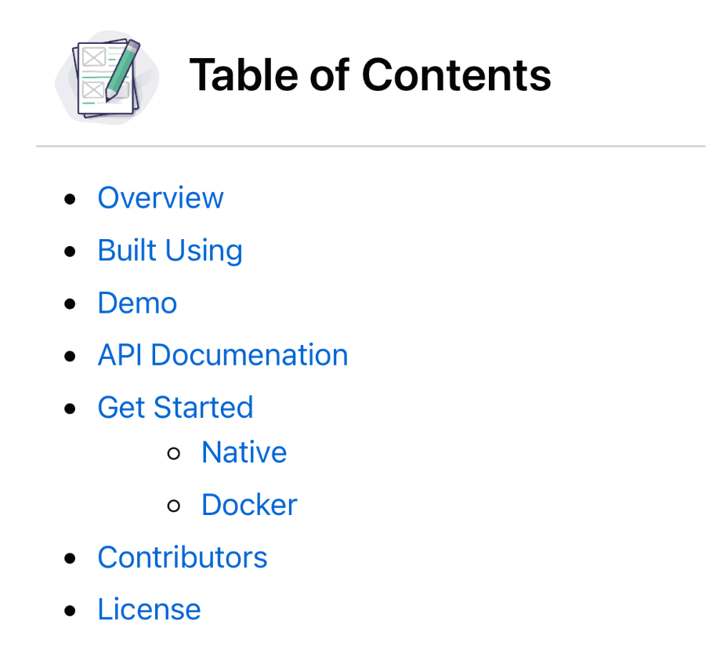

API Repo ReadME
The ReadME is available [link]
Do we need add another sections

Slide 8

API Documentation
I will document small part of the API code
Generate the API Documentation using Swagger

Slide 9
Coding
Files (RuxAiLab):
Files (API):
Models:
./src/models/AudioSentiment.js
Controllers:
./src/controllers/AudioSentimentController.js
Views:
./src/views/admin/SentimentAnalysisView.vue
Molecules:
./src/components/molecules/AudioWave.vue
./src/components/molecules/ModeratedTestCard.vue
Organisms:
./src/components/organisms/SentimentTranscriptsList.vue
./src/components/organisms/UserModeratedSentiment.vue
Flask App:
app/app.py
AI Model Files:
ai/src

Slide 10

Wikki
Vue and Vuetify Study Guide [here]
Deployment Study Guide [here]
Speech2Text (Not ready) [here]

Slide 11

Timeline & New Tasks
Task | Day
Transcription Section | Monday
Delete Region | Tuesday
Cooperators Section | Wednesday
Add Time to Timeline | Thursday
Buffer | Friday - Saturday
Follow Up Meet | Monday
Complete BE ReadMe | Monday
Refactor BE (Small Part) | Tuesday
API Documentation | Tuesday
Check Docker Image | Wednesday

Slide 12

Final Submission
We need to include the API Repo + READMe [here]
PR Request in RuxAiLab [link]
Wikki links
Follow Up Sheet Link [here]
Something else?!
Where to submit these and in a google doc or sth else

Slide 13
Contribution After GSoC
Enhancements on the Flow of this feature
Fix Bugs that may appear during usage
Using Async APIs for better timing
Deploying Model
Enhance UI
Help others contribute to add new features
Sentiment Analyze the Text Answers

Slide 14

Questions To Mentors
When will we show other mentors the progress
What Do I need to do for final evaluation
PRs

Slide 15


Feedback
Give me your Feedback about progress till now &
Next Steps
Small notes = Great Work

Slide 16

Thank You
For all your support and guidance during the last few months.
Karine & Basma <3

Slide 17





Thank you
Any Questions?
BasmaElhoseny01
basmaelhoseny01
basmaelhoseny6@gmail.com

